Slide 1
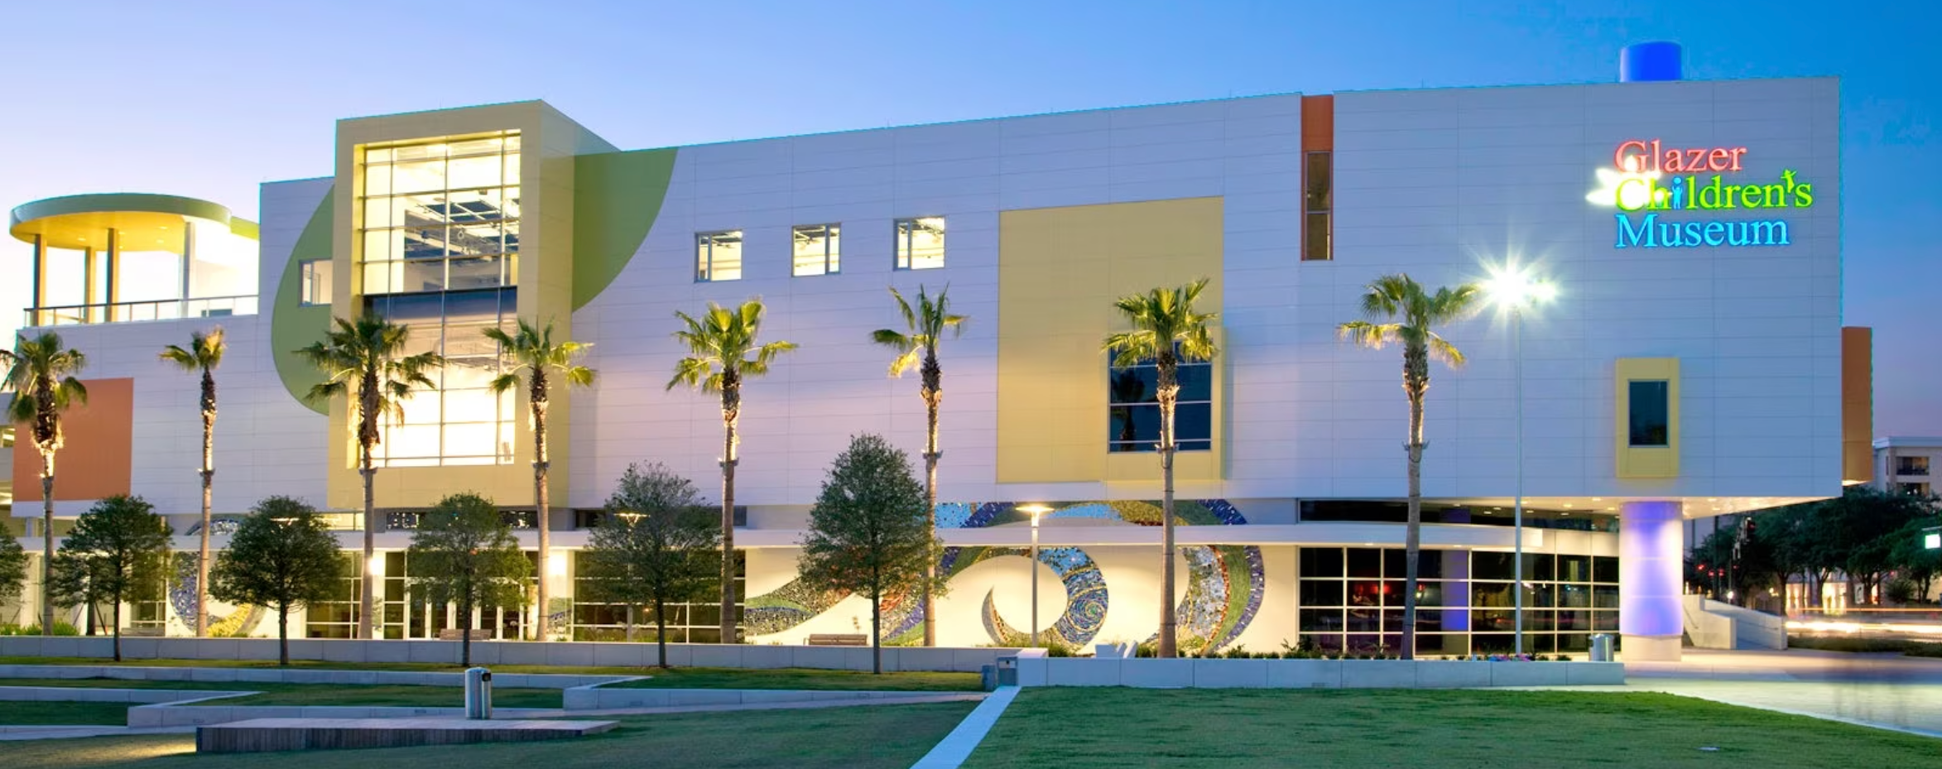
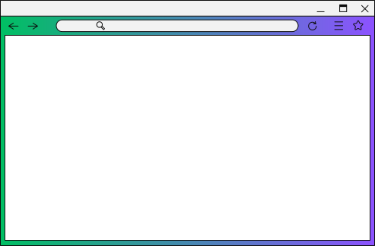

SOFTWARE DESIGN AND ENGINEERING
Glazers Children Museum App Pitch
Sofia, Annie, Byrton, Mikey, Jamil, and Seha

Slide 2
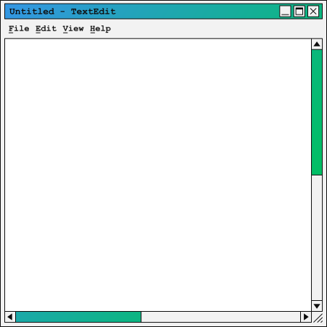
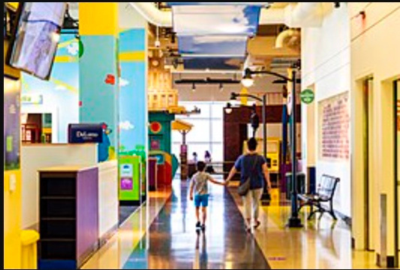

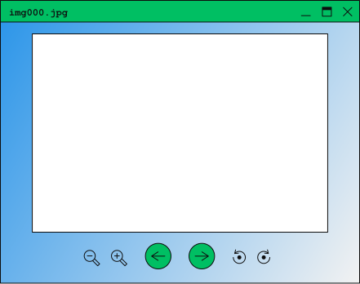
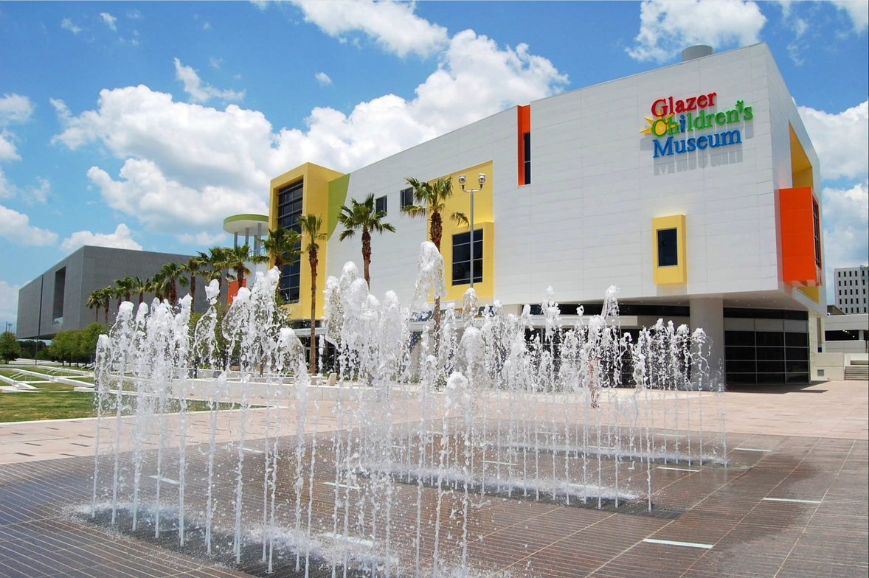
Overview
01 | About us
02 | Pitch
03 | Website Preview
04 | Conclusion

Slide 3
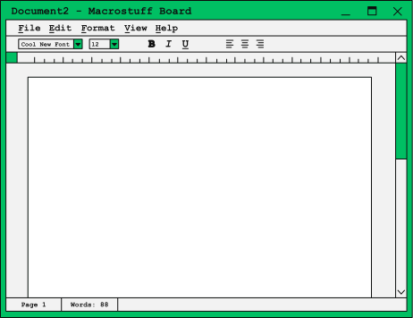
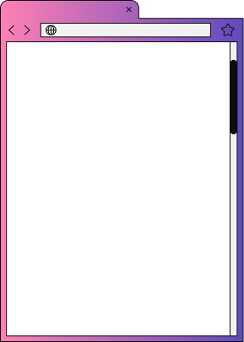
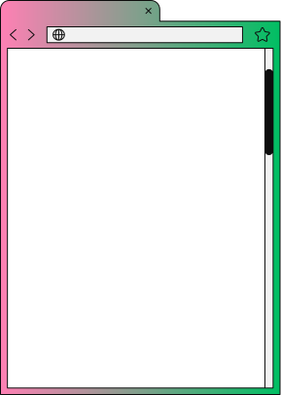


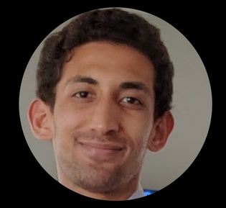

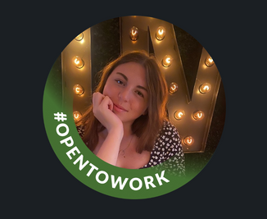
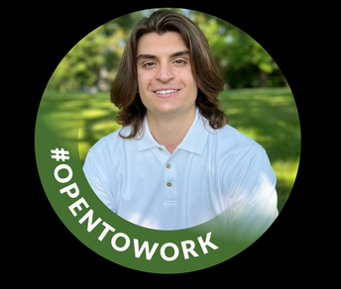
Back to Agenda Page
Annie Rome
Bachelor of Science in Computer Science and Psychology
Senior
Bryton Montgomery
Bachelor of Science in Computer Science
Sophomore
Sofia Mucci
Bachelor of Science in Data Science with a minor in Mathematics
Junior
About Us
Mikey Dimucci
Bachelor of Science in Computer Science with a minor in Cybersecurity
Sophomore
Jamil Velez
Bachelor of Science in Computer Science
Junior
Sneha Patel
Bachelor of Science in Computer Science with a minor in Digital Media
Sophomore

Slide 4
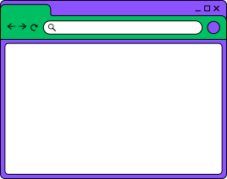
Back to Agenda Page
Pitch
Discover our Glazers Children Museum App, the ultimate museum companion app that enhances every visit! With features like instant language translation, easy navigation, and detailed play insights, exploring has never been more accessible. Plan your day with our interactive map and extend your adventure to nearby play areas. Engage, learn, and give back with personalized recommendations, donation options, and a feedback form to share your experience.

Slide 5

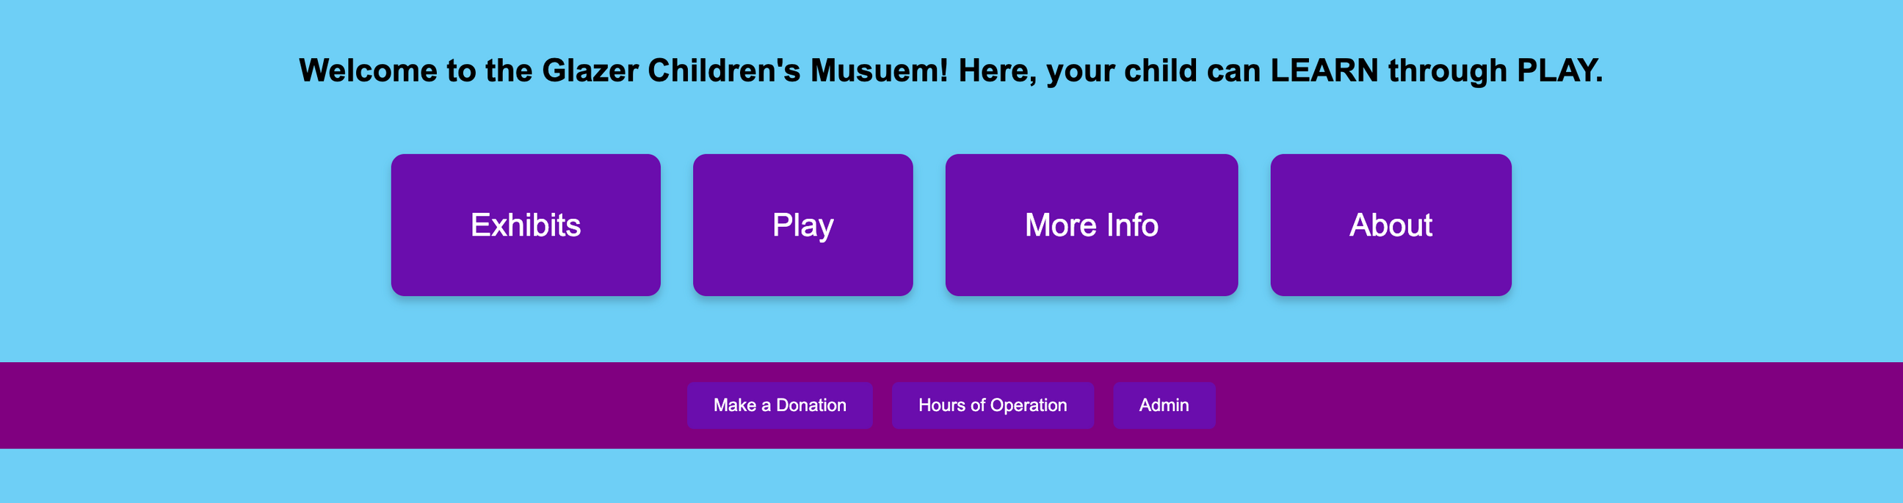
Website Preview

